Slide 1

ENHANCING DATA VISUALIZATION AND ANALYSIS:
A STREAMLIT-BASED SURVEY ANALYSIS PROJECT
Karunakaran L*, Rathnayaka R.M.K.T , and Chandrika Malkanthi
Department of Physical Sciences and Technology,
Faculty of Applied Sciences,
Sabaragamuwa University of Sri Lanka
*klluxshi99@gmail.com

Slide 2


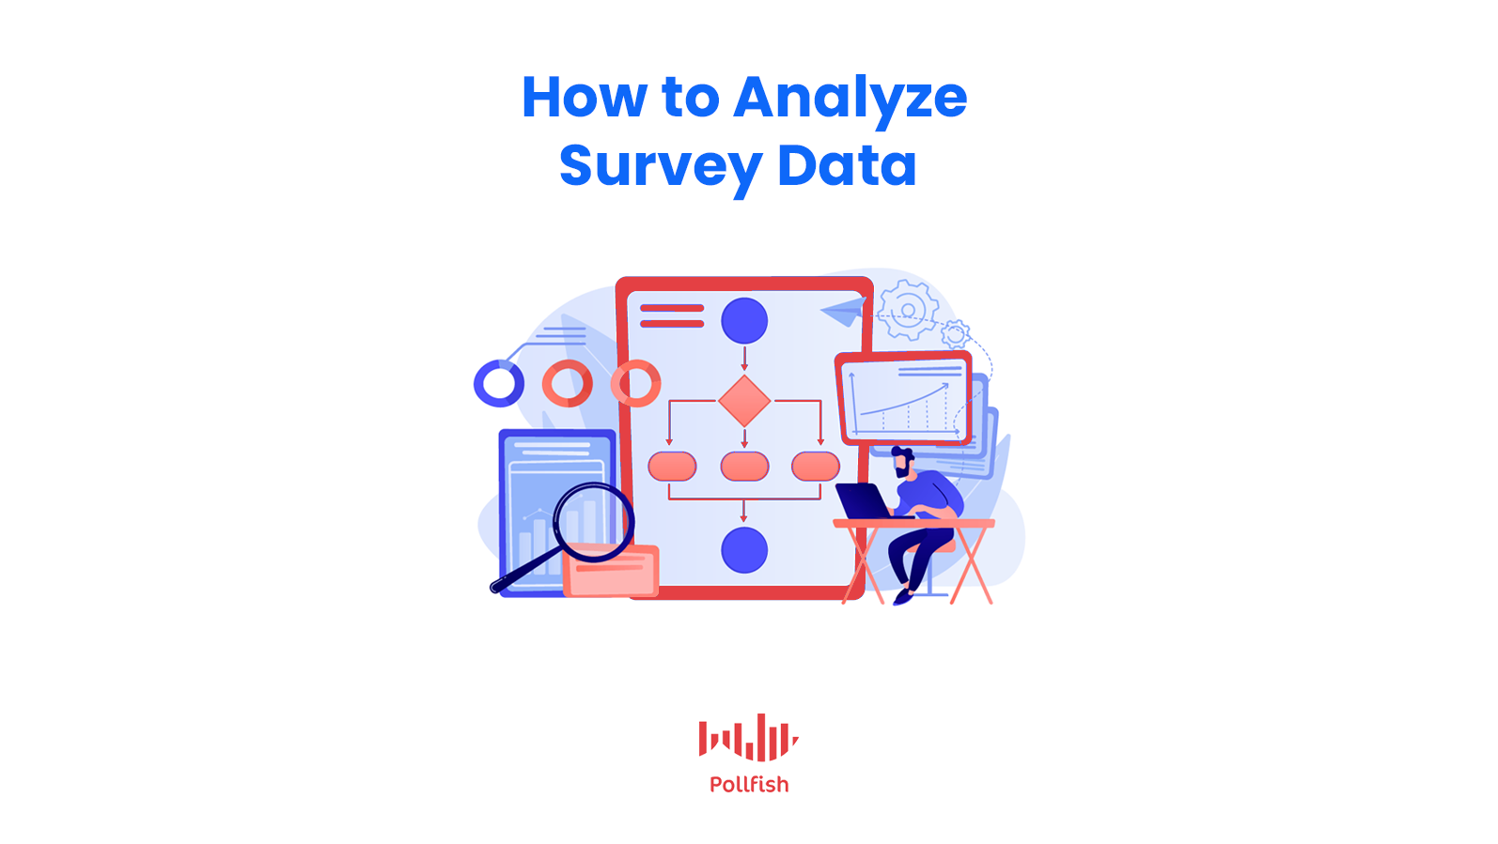


CONTENTS
INTRODUCTION
BACKGROUND
LITERATURE REVIEW
RESEARCH GAP
OBJECTIVES
METHODOLOGY
RESULTS
CHALLENGES
CONCLUSION AND FUTURE WORK
REFERENCES

Slide 3
INTRODUCTION
Survey data analysis is a vital tool in sectors like the software industry, healthcare, and social services [1], helping organizations extract valuable insights from data.
Traditional methods that rely on static reports and manual data entry are slow, error-prone, and time-consuming [1].
This project addresses these limitations by developing an interactive, automated survey analysis system [2] that ensures efficiency, accuracy, and real-time insight generation.

Slide 4
2. BACKGROUND
In modern data-driven environments, surveys are a common method of collecting information about customers, stakeholders, and target groups [3].
Traditional approaches involve manual compilation and analysis, which are not scalable for large datasets [4].
With the rise of Python-based data processing and web-based dashboards, automation is becoming a practical and cost-effective solution.
By integrating real-time analysis and visualizations, organizations can react faster to trends, improve decision-making, and maintain data accuracy.

Slide 5
3. LITERATURE REVIEW
Table 1: Existing studies related to survey data analytics
Ref No. | Heading | Key Findings | Limitations
[1] | Python for Survey Data Analysis | handle large-scale survey datasets, significantly reducing manual workload through automated preprocessing and analysis. | Focused only on preprocessing and analysis, with limited exploration of visualization or real-time capabilities.
[2] | Real-Time Data Visualization for Decision Making | Interactive dashboards using Streamlit and Matplotlib improve survey trend interpretation and support faster, data-driven decisions. | Did not address integration with predictive analytics or advanced statistical modeling.

Slide 6
3. LITERATURE REVIEW
Table 1: Existing studies related to survey data analytics
Ref No. | Heading | Key Findings | Limitations
[3] | Predictive Analytics in Dashboards | Reviewed case studies on integrating predictive analytics into learning analytics dashboards, showing improved decision-making and proactive insights. | Limited to educational settings; lacks direct application to general business or survey analytics.
[4] | Streamlit for Survey Applications | Demonstrated building a Streamlit-based application for survey data, enabling easy deployment of interactive dashboards without complex coding. | Focused on a single implementation, with limited discussion of scalability or performance in large datasets.

Slide 7

4. RESEARCH GAP
Existing methods lack full automation, real-time trend detection, and user-friendly interfaces for large survey datasets. Most studies focus on specific domains or single examples without addressing scalability and cross-industry applications.
There is a need for a scalable, automated, real-time platform that improves accuracy, reduces human intervention, and supports dynamic visualizations for better decision-making.
Figure 1: Combination of Python and big data

Slide 8
5. OBJECTIVES
Main Objective:
To design and develop an automated platform for efficient survey data management, analysis, and real-time visualization.

Slide 9
5. OBJECTIVES
Sub-Objectives:
To enable real-time data visualization and trend analysis through a user-friendly interface.
To improve accuracy and reduce human intervention by automating data cleaning and processing.

Slide 10
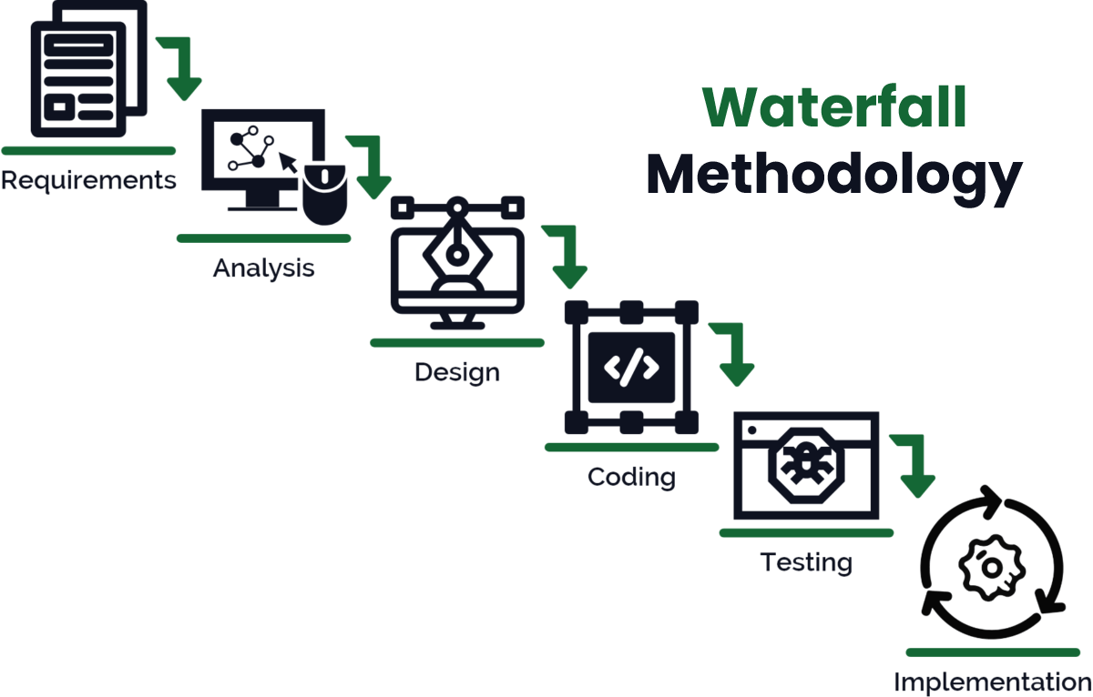

6. METHODOLOGY
Development Model:
Figure 2 : Waterfall model approach

Slide 11
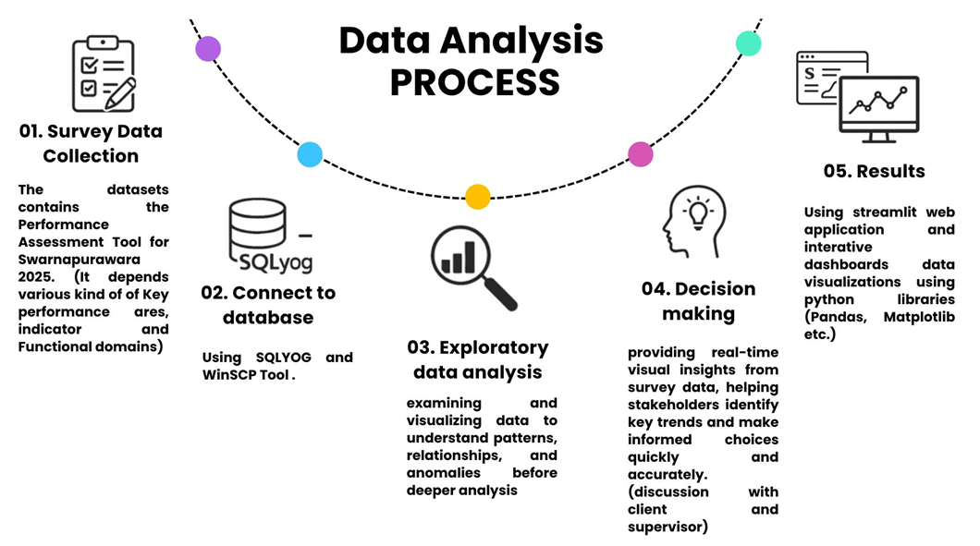
6. METHODOLOGY
Figure 3 : Data Analysis Process

Slide 12









6. METHODOLOGY
Tools & Technologies:
Numpy data cleaning and transformation, Pandas for data handling, and Matplotlib for visualization.
Streamlit for building interactive dashboards.
Figure 4 : Tools and Technologies

Slide 13
7. RESULTS
Built an interactive real-time dashboard for survey data analysis.
Achieved faster and more accurate survey processing compared to manual methods.
Improved visualization quality and trend detection, making interpretation easier.
Enabled better and quicker decision-making for researchers and businesses.

Slide 14
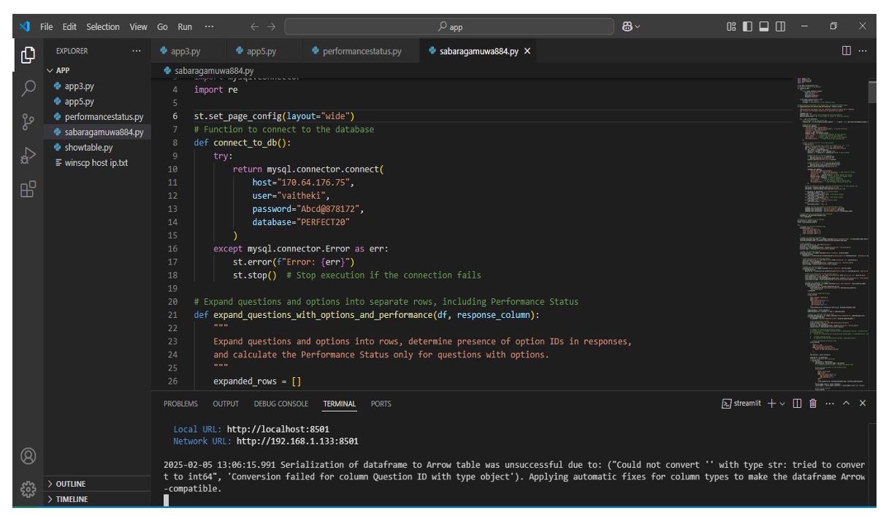
7. RESULTS
Figure 5 : Python approach

Slide 15
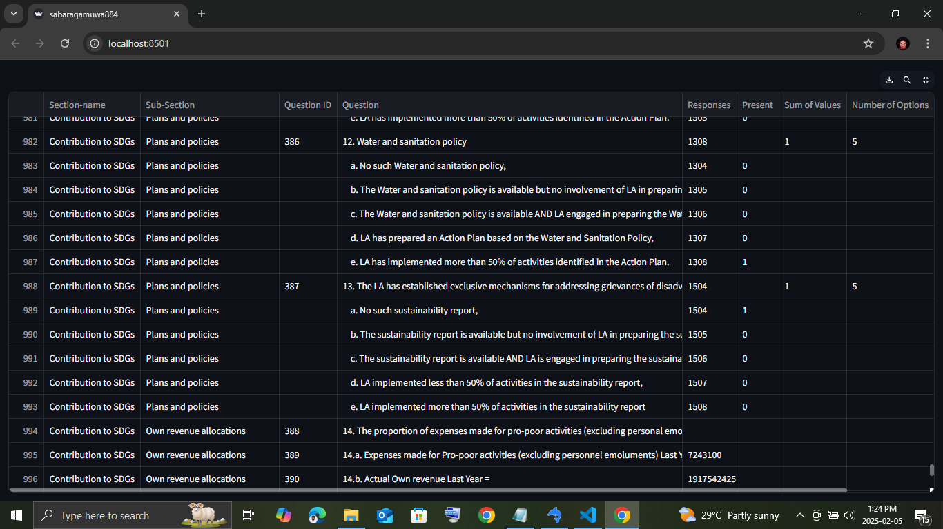
7. RESULTS
Figure 6: Data is maintaining in the streamlit

Slide 16
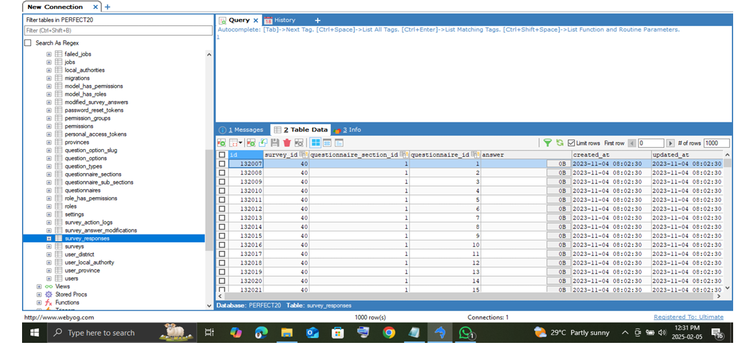
7. RESULTS
Figure 7 : Using Sql-yog database

Slide 17
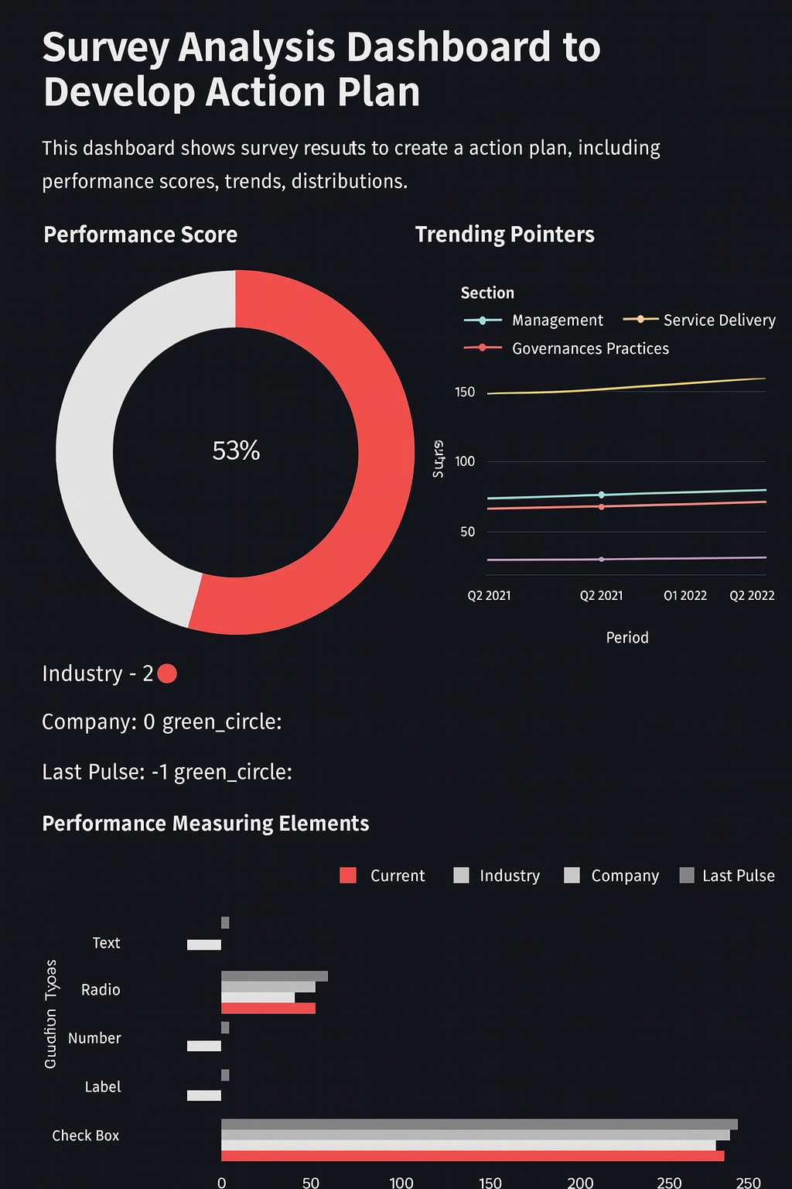
7. RESULTS
Figure 8: Interactive Dashboard

Slide 18
8. CHALLENGES
Real-time filtering technology presented difficulties because we had to optimize both dynamic updates and responsive performance through proper optimization work.
The proper setup of file permissions and dependencies for WinSCP demands attention to ensure quick access during system usage by the client’s personnel.

Slide 19
9. CONCLUSION & FUTURE WORK
The system provides an efficient, accurate, and user-friendly way to analyze survey data.
It reduces manual effort, maintains data integrity, and speeds up insight generation.
Future integration with machine learning can enable predictive capabilities for even deeper analysis.

Slide 20
REFERENCES
No. | References
[1] | Hernandez, J., Martinez, L. and Patel, R., 2020. Python for survey data analysis: Leveraging Pandas and NumPy for large-scale datasets. Journal of Data Science and Analytics, 8(2), pp.45–57.
[2] | Smith, A. and Jones, M., 2021. Real-time data visualization for decision making: The role of interactive dashboards. International Journal of Business Intelligence, 12(3), pp.101–115.
[3] | Ramaswami, G., Susnjak, T., Mathrani, A. and Umer, R., 2023. Use of predictive analytics within learning analytics dashboards: A review of case studies. Technology, Knowledge and Learning, 28(2), pp.959–980.
[4] | Dean, G., 2021. Building an application with survey data on Streamlit. Towards Data Science, 26 April.

Slide 21
Q & A

